Slide 1
Location Analysis for an Italian Restaurant in Hamburg
Capstone Project - Final Assignment
Kay W. Fiolka

Slide 2
The business Problem
A customer of our data science consultancy wants to open an Italian restaurant in the inner city of Hamburg and wants to know in which borough - Altstadt, Neustadt or HafenCity

Slide 3
The Main Data
Demographic data from the official statistic office in Northern Germany (amount of residents, age, income and so on)
Foursquare API for venues in the near, especially other restaurants

Slide 4
The Methodology
Obtaining demographic data and intense explorative data analysis concerning the main criteria residents, age and income
Obtaining venues via the Foursquare API and analyzing them concerning type, amount, vicinity
Clustering the boroughs via k-Means
Defining new key performance indicators on basis of the analyzed and pre processed data (for example restaurants per resident)
→ Giving a recommendation on basis of the work for the optimal borough

Slide 5
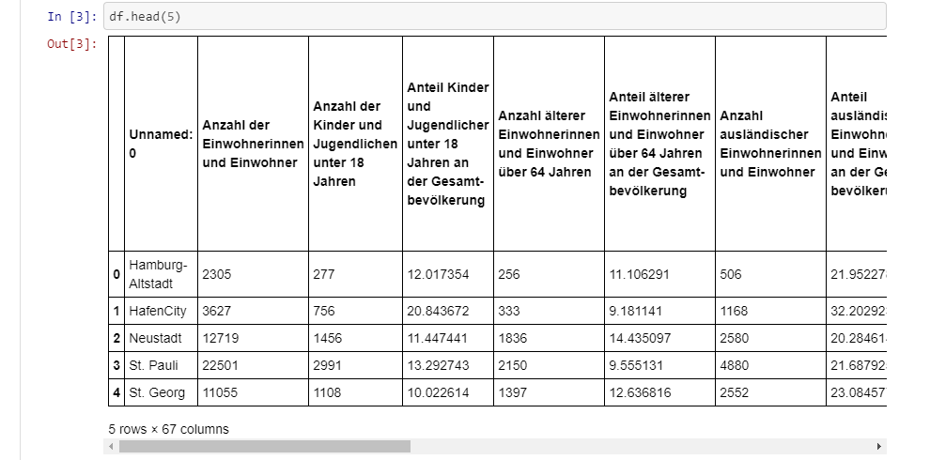
Intermediate Data 1
Obtained data from the statistical office with 67 columns, which had to be reduced and properly analyzed.:

Slide 6
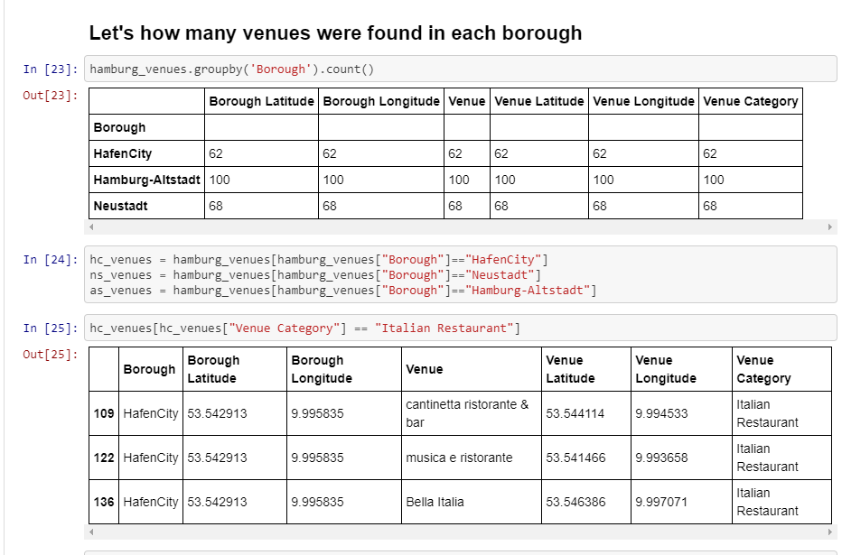
Intermediate Data 2
Obtaining the needed data about venues / restaurants from Foursquare (here as an example for all venues in the boroughs and then each borough divided into restaurants in general and Italian restaurants:

Slide 7
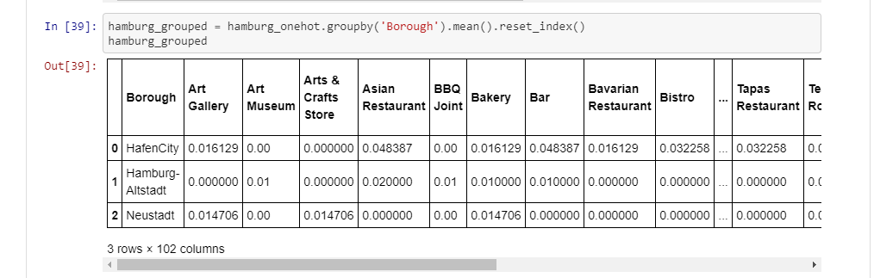
Intermediate Data 3
Preparing the data for the clustering of the boroughs via k-Means on basis of their venues:

Slide 8
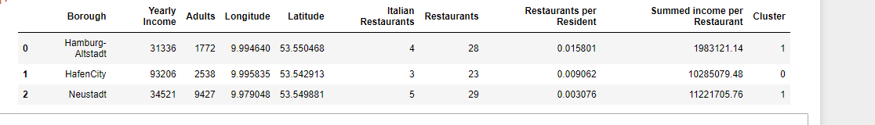
Results
On basis of the explorative analysis, inferentiell statistics work and clustering I can recommend to open the restaurant in the borough Neustadt.
It has the best ratios of income, age and venues / potential customers.
Now – good luck for the founding and opening of the restaurant! ☺

